Slide 2
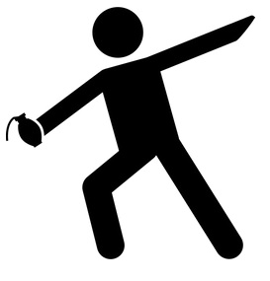
HAND GRENADE THROWING
START: Day 1 / 09:00 hrs.
RESULT: The highest total number of hits determines team´s rank.
LOCATION: Sports ground by the Department of Physical Education and Sport.
350g rubber imitation of hand-grenade
3 x 6 meters target + frame of target at 30 meters distance
Every members has 10 attempts
Don´t cross the start line (crossing the start line = missed shot)
Run-up is allowed
White flag is valid attempt and red flag is false attempt
National battledress (cap is allowed / glasses are forbidden)

Slide 3
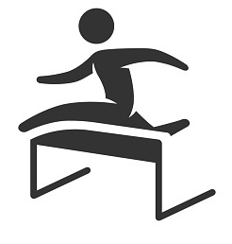
OBSTACLE COURSE RUNNING
START: Day 1 / 10:30 hrs.
RESULT: The lowest total time means the best position.
LOCATION: Sports ground by the Department of Physical Education and Sport.
200 meters length
National battledress (cap and gloves are allowed)
1 run for each member of team
SPECIAL RULES: Hand grenade throwing at 3 x 6 meters target:
First ONLY / First + Second grenade hit the target: -5 seconds
Second grenade hits the target: 0 seconds
Missing the target by both grenades : +10 seconds

Slide 4
SWIMMING RELAY 6 x 50 meters
START: Day 1 / 14:00 hrs.
RESULT: Total time of the team determines a rank in discipline.
TYPE: Open-water swim/swimming pool
LOCATION: Open water area – pond in Bobrovec.
Each member of the team swims 50 meters
Free-style swim
Battledress and belt (bandage) is provided by organizer (swimming cap and glasses are allowed)
Don´t use / touch the swimming rope to help yourself
Handover relay by hand

Slide 5
SHOOTING
START: Day 1 / 16:00 hrs.
RESULT: The team´s results is given by the summary of points achieved by its members. In case of the identical results in shooting, the team that scored more shots worth the higher value will gain more points of both rounds in final results.
TYPE: Virtual shooting.
LOCATION: Simulation centre; Armed Forces Academy venue.
Shooting in standing position with airsoft gas CZ EVO3 and pistol CZ P09
1st round – CZ P09 - target distance is 15m in form of silhouette paper target with circles
2nd round – CZ EVO3- target distance is 25m in form of silhouette paper target with circles
First 5 zero shots followed by 10 shots; time limit for one shooter is 2 minutes.
Time limit for one shooter is 1 minutes in every round.
National battledress

Slide 6
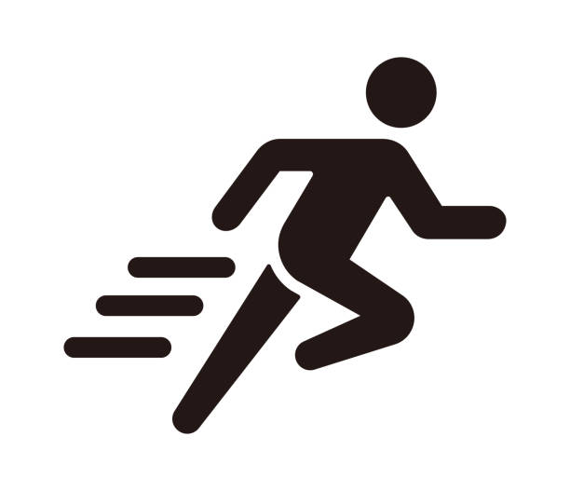
6 KM TRAIL RUNNING
START: Day 2 / 08:30 hrs.
RESULT: The result of a team is given by the sum of the times of its members. The winner of the discipline is the team with the fastest sum of times.
TYPE: cross-country run.
LOCATION: Iľanovo village.
6 km track length
188 meters elevation gain
Rocks, Clay and Grass surface
National battledress and athletic shoes
Hit the segment on Strava !

Slide 7
TRAIL RUN MAP AND ALTITUDE

Slide 8
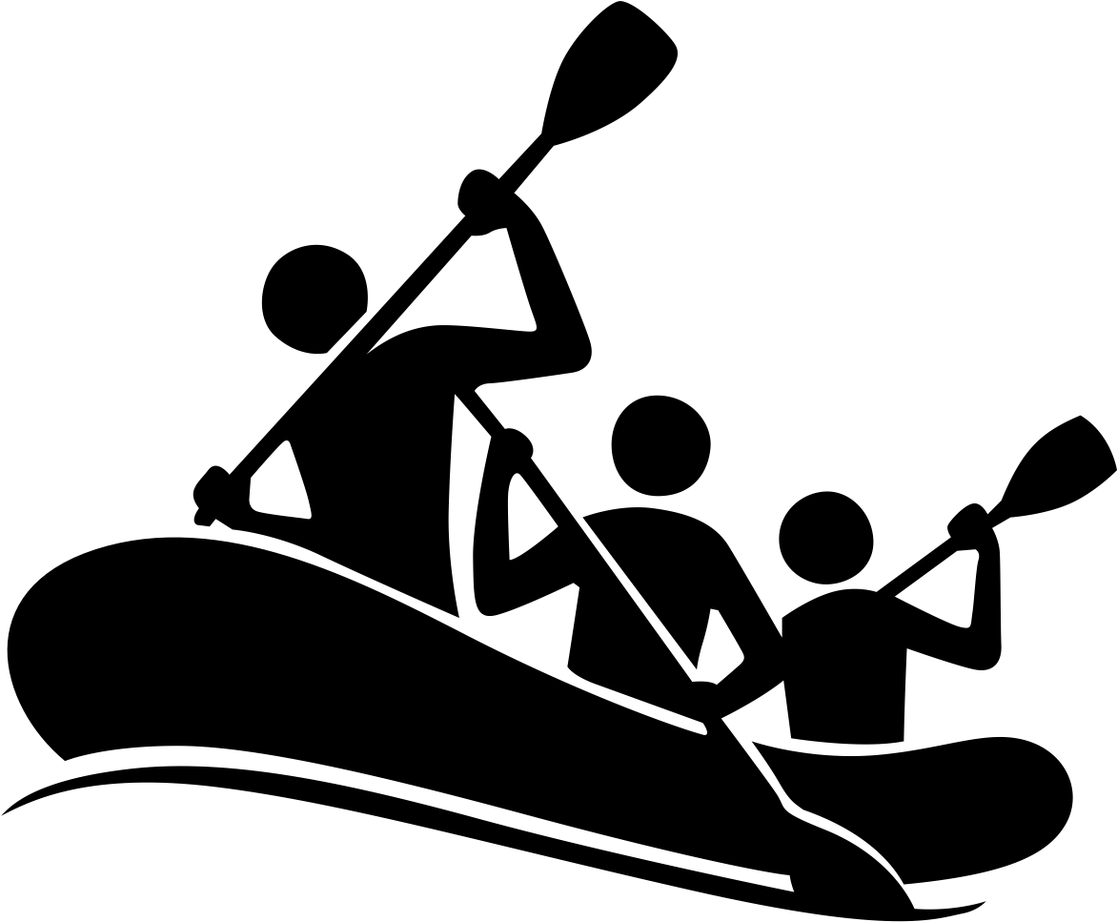
RAFTING
START: Day 2 /training 10:15hrs.; race 11:30 hrs.
RESULT: The lowest total time of both runs determines rank in the event.
TYPE: Wild-water rafting.
LOCATION: Ondrej Cibak White-water Slalom Course.
Organizer provides rafts, life jackets, helmets and rescue service
Life jacket, helmets are mandatory
2 runs of 6 person raft
400 meters length
7,5 meters drop
Neoprene is recommended but not compulsory (not provided by organizer)
1-2 training rides = 15-20 minutes (according to time available)

Slide 9
Ondrej Cibak White-water Slalom Course

Slide 10
COMPLEMENT TO THE RULES
ASSIGNING THE PLACINGS
The winner of the whole competition is the team with the lowest total addition of ranking in the individual disciplines. In case of the same time or position in discipline, ranking is divided. In case of the same total addition after the 6th discipline, it´s obstacle course better ranking that decides the results.
INJURY
If there´s an injury during the competition and the racer is unable to continue in the competition, lots are drawn from the remaining team members, the „winner“ of the drawn will go through the discipline twice. Each discipline is drawn individually.
OBSTACLE COURSE
If a racer doesn´t master technically a hurdle but reaches the finish, 1 minute will be added to final time. If a racer doesn´t reach the finish at all, the final time will be counted of 5 minutes.
SWIM
Athlete must be stand into the water and his hand must be touched on color marker. Color marker on the rope is the rellay handover. If racer use the rope line for helping and if racer start early than get rellay handover team time will be counted of 5 minutes penalty.
TRAIL RUN
If a racer doesn´t reach the finishor doesn ´t start, then they will get the get the last rank (also more racers). In case of the same total addition of the ranking at more teams, it ´s the total addition of times in a team that decides.
RAFT
If there isn´t a complete team on a boat reaching the finish, 1 minute will be added to the final time. If a boat without a crew on board ,,up the bottom´´ reaches the finish, the time will be counted of 5 minutes.

Slide 11
GOOD LUCK !

